Slide 1
London Trains

Slide 2



Nudge Algorithm
Optimal Staging Zone Target for Nudge Followers

Slide 3
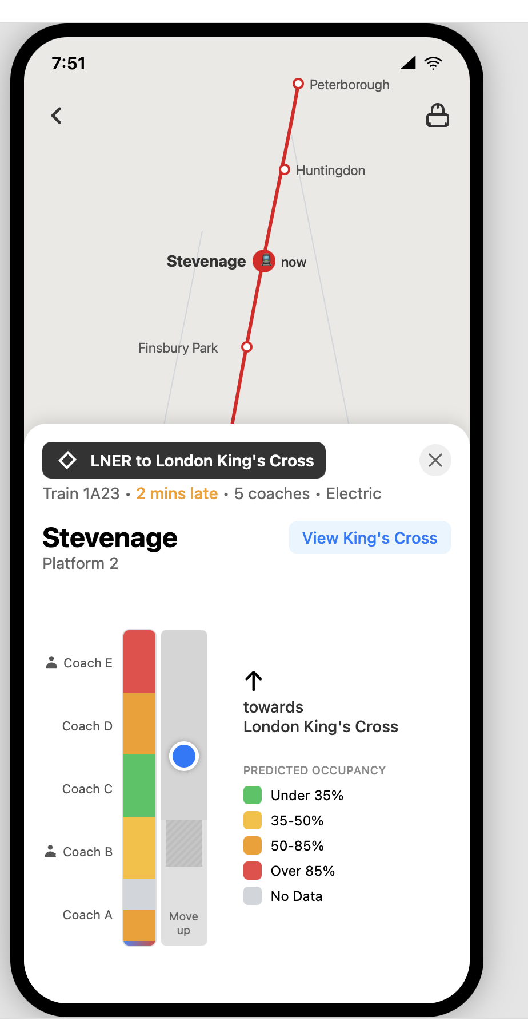
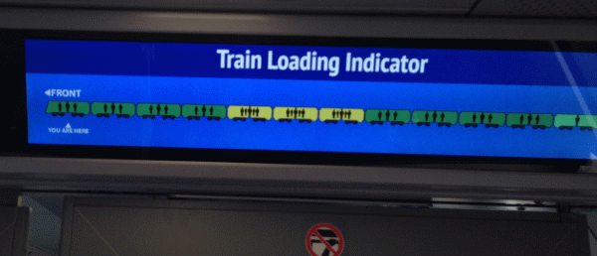
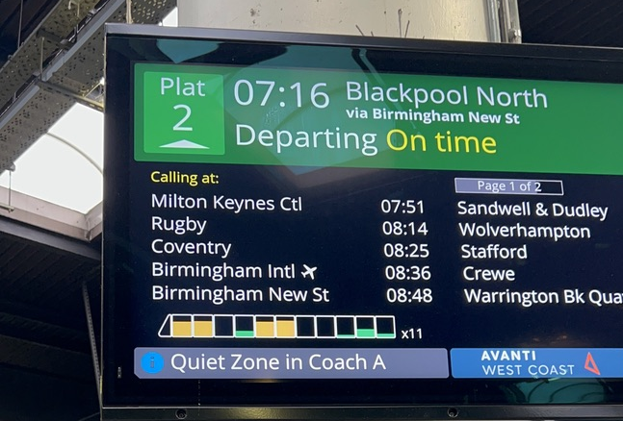
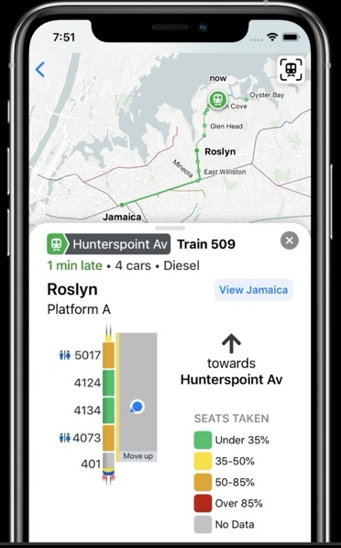
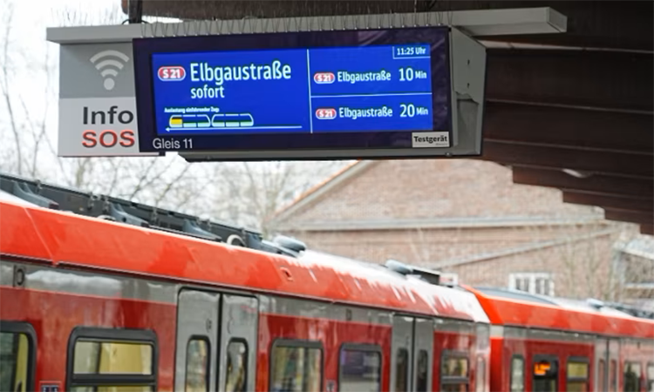
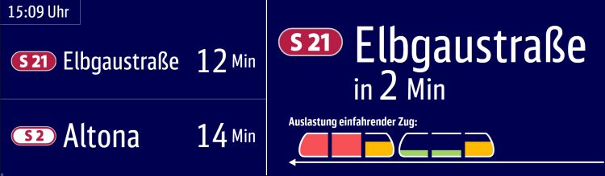
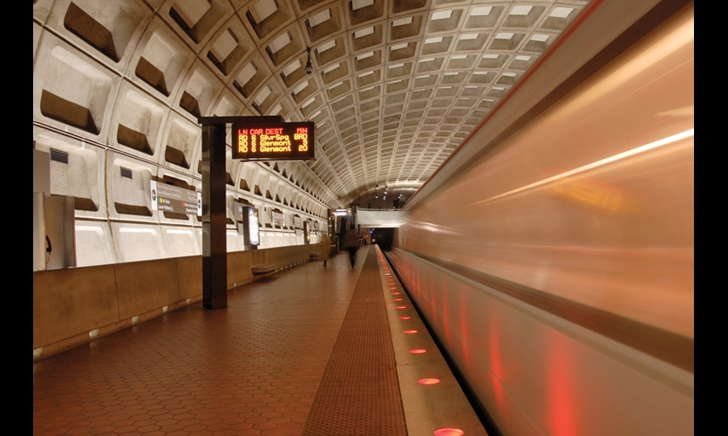
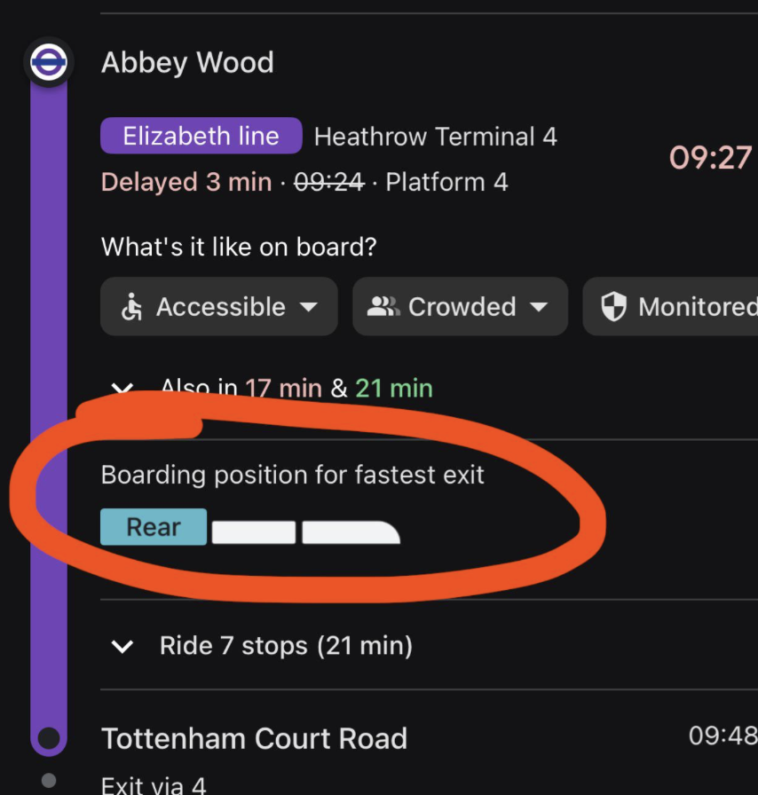
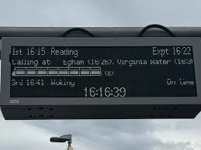

Slide 4
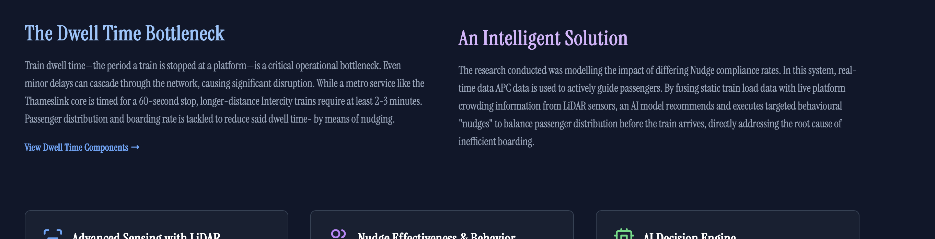
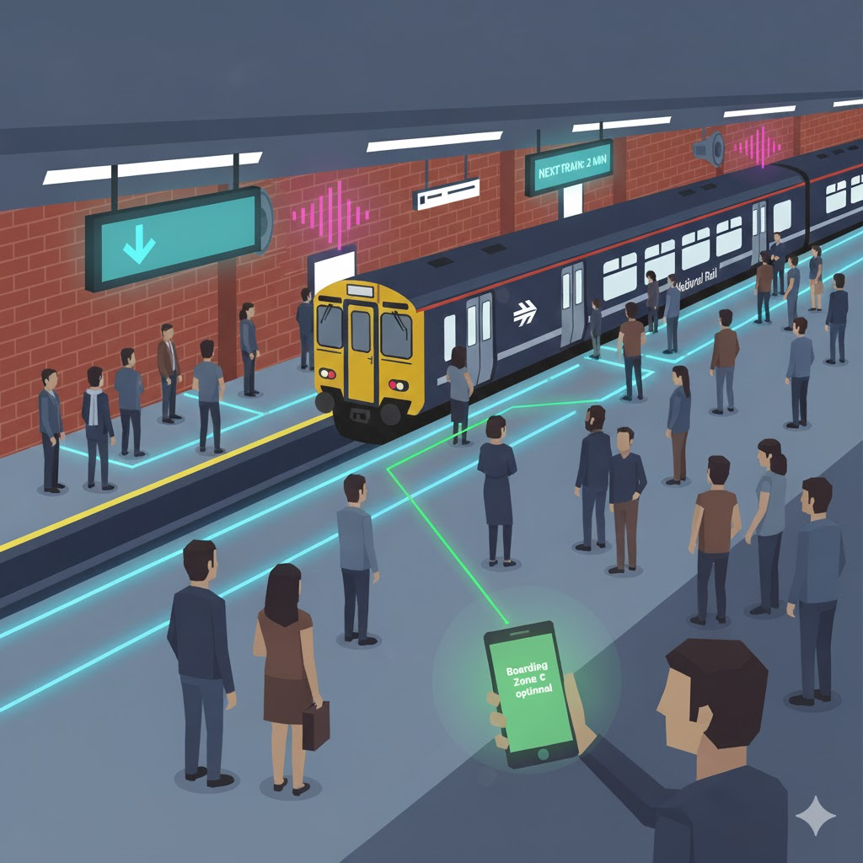

Slide 5
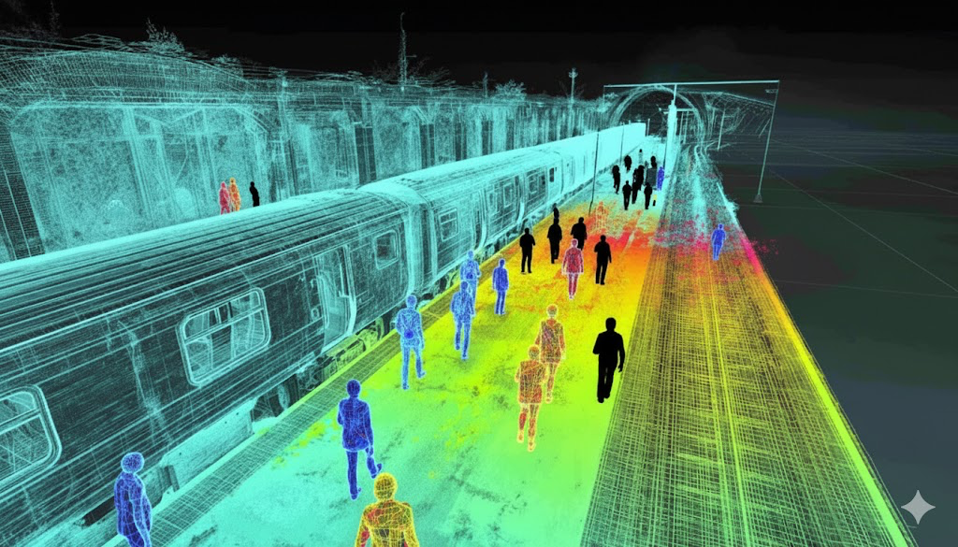
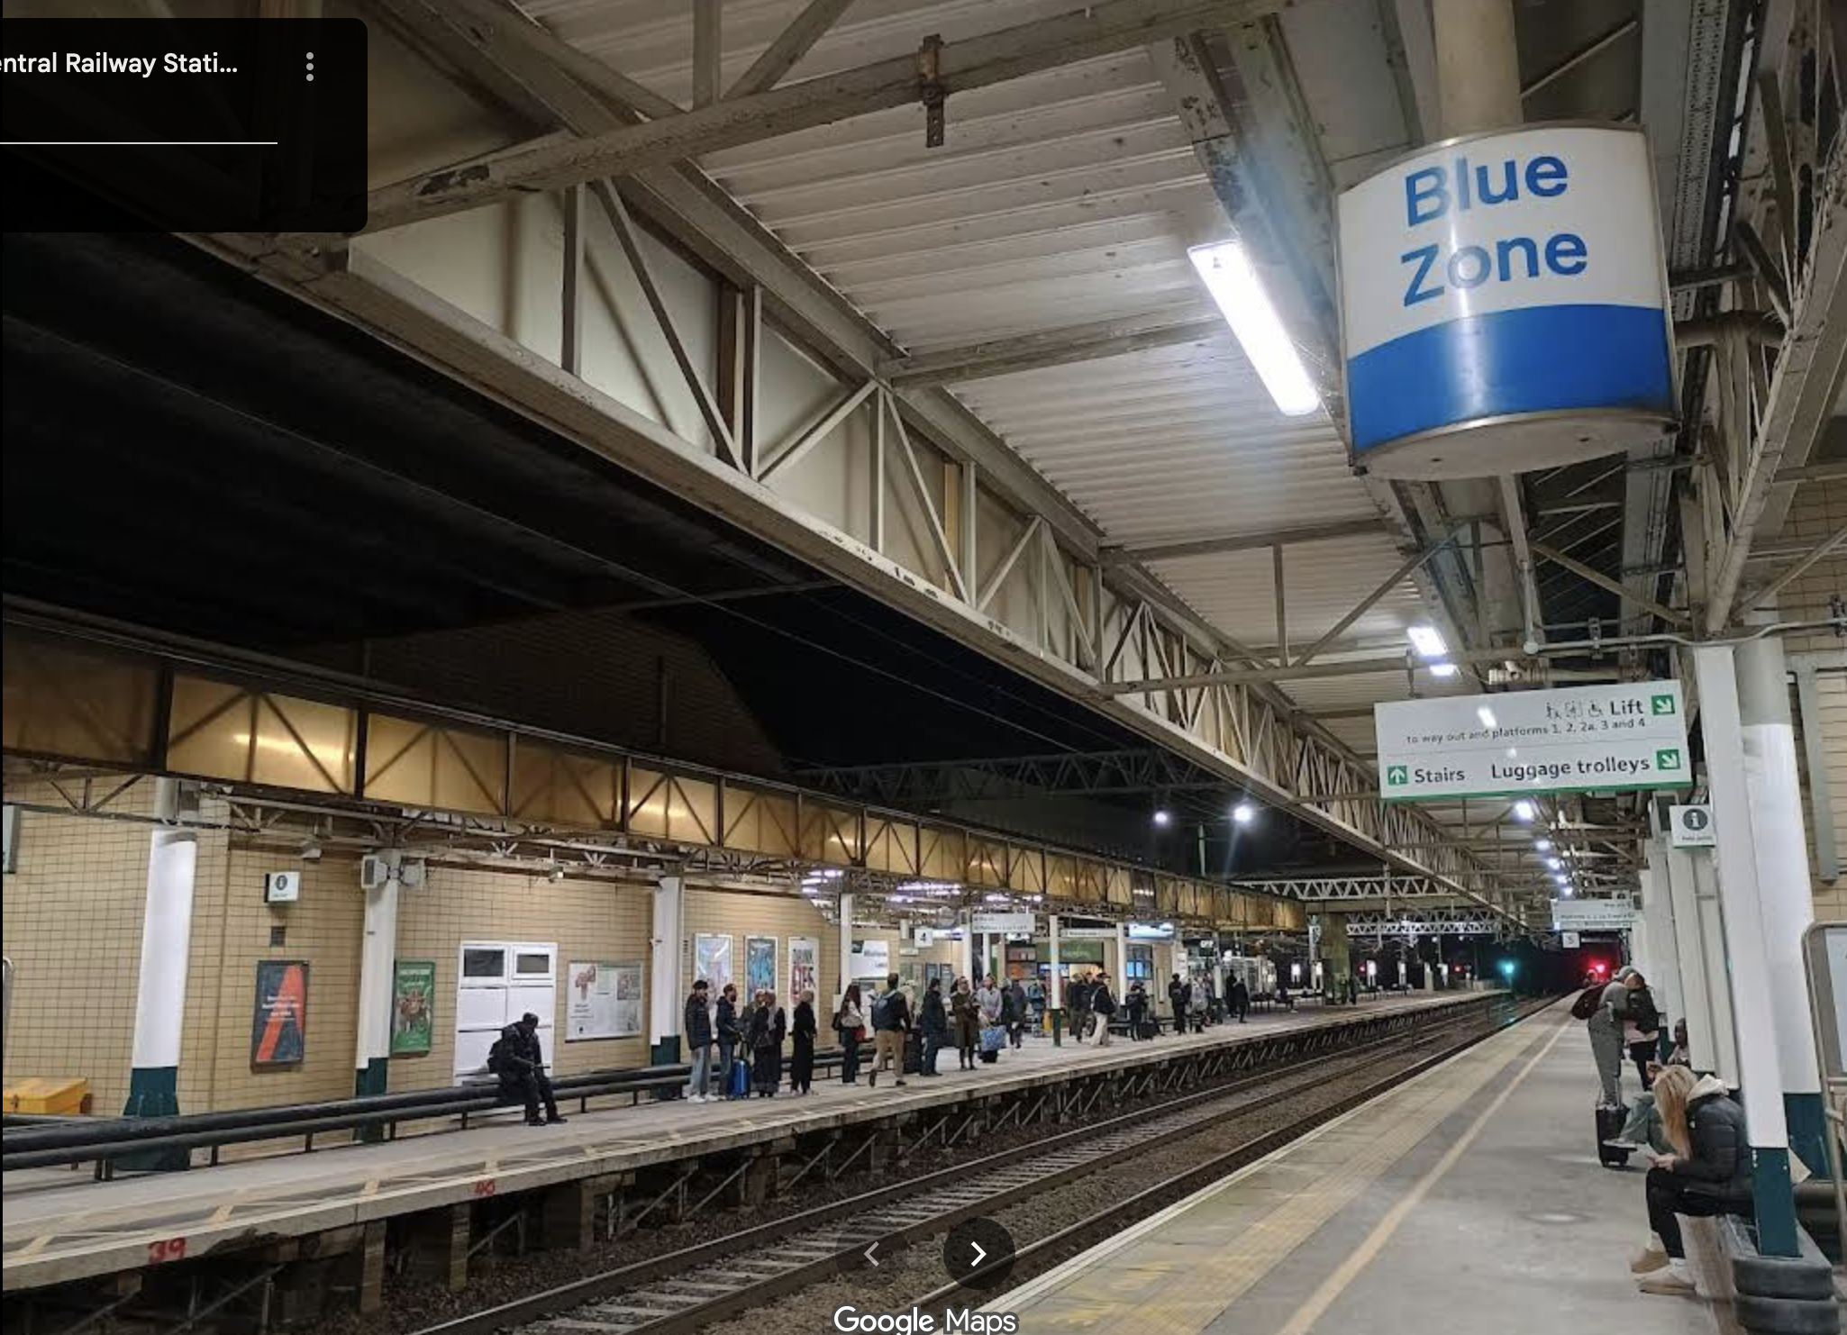
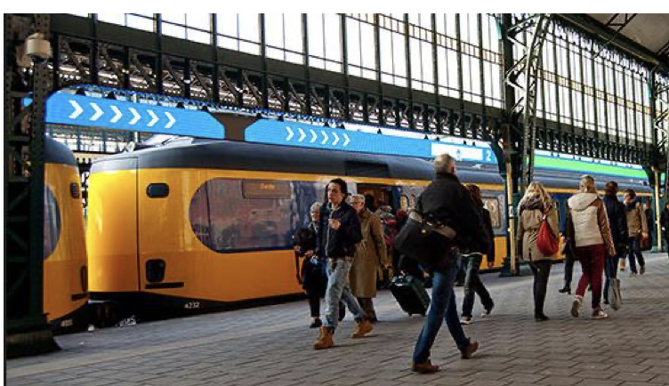

Slide 6
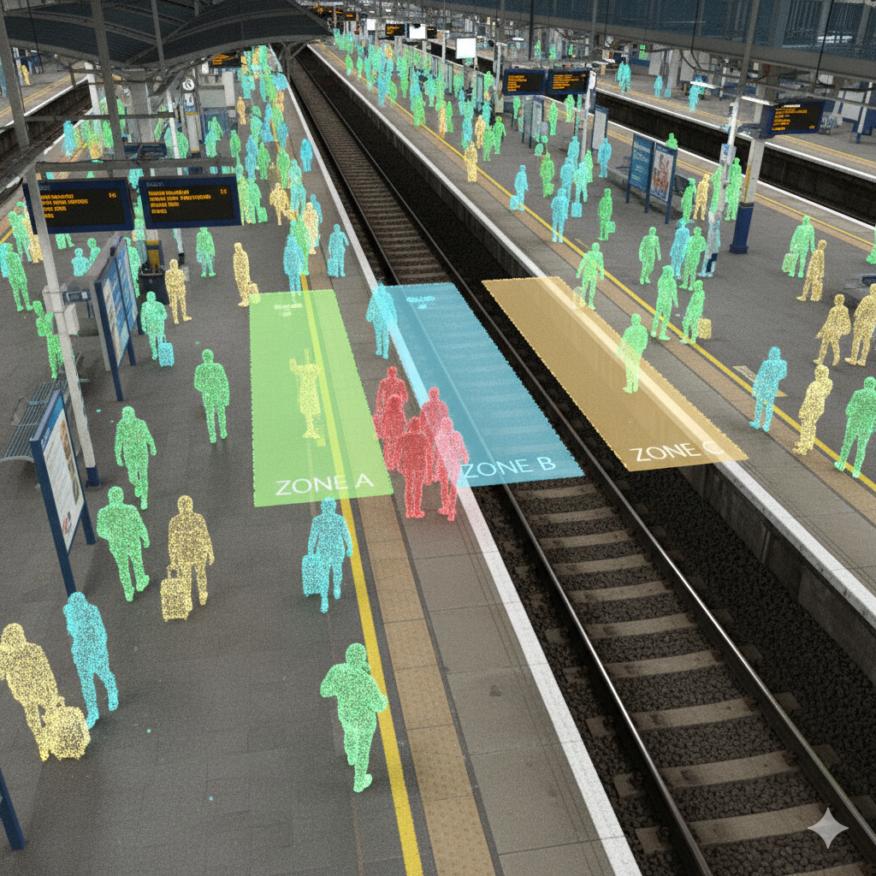
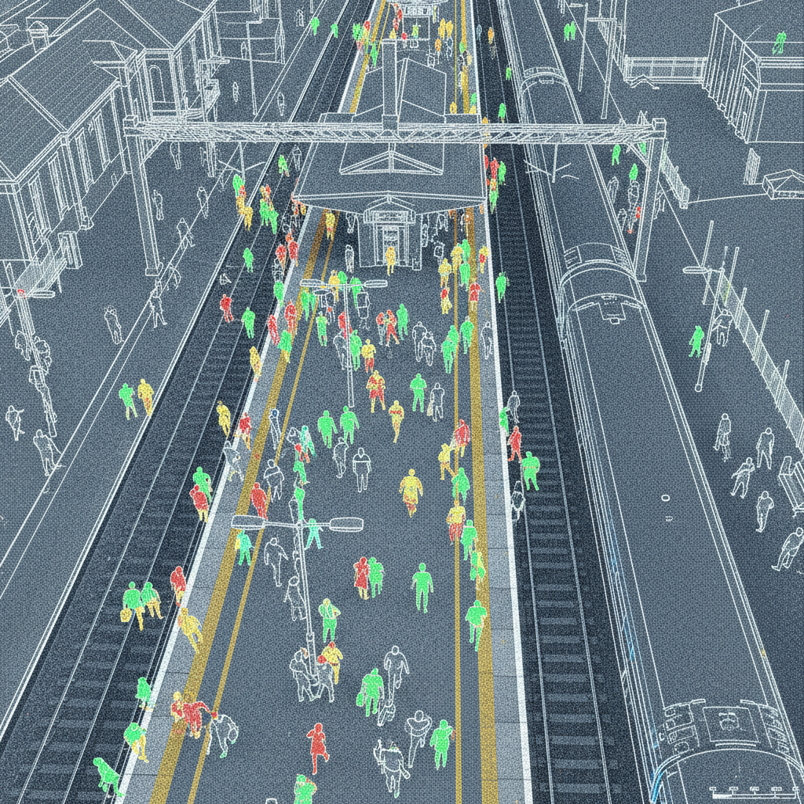
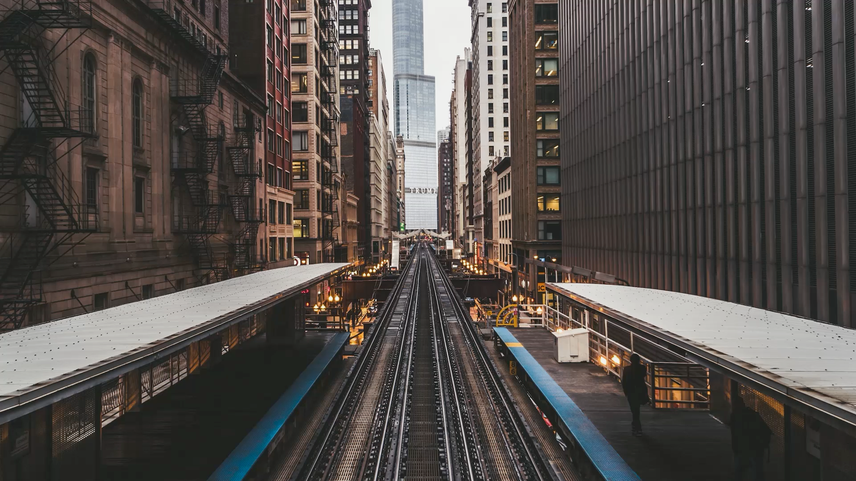
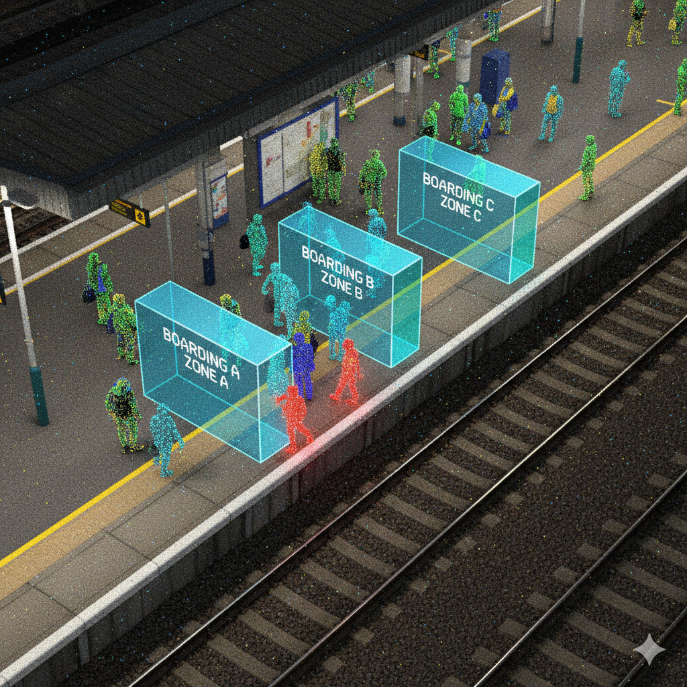
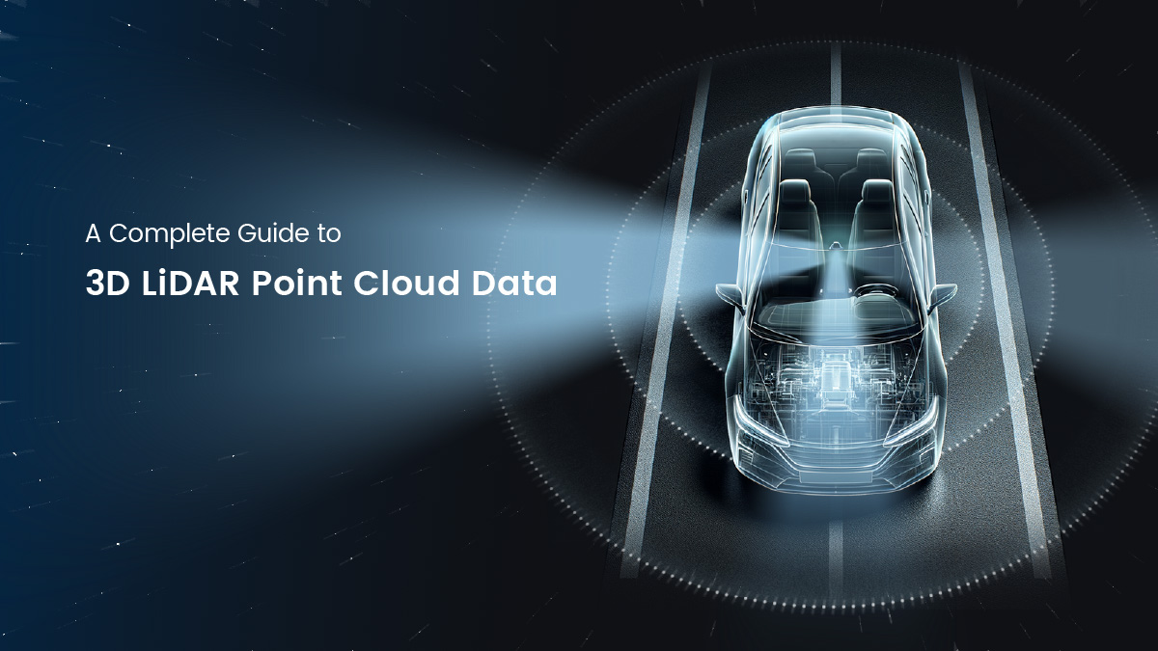
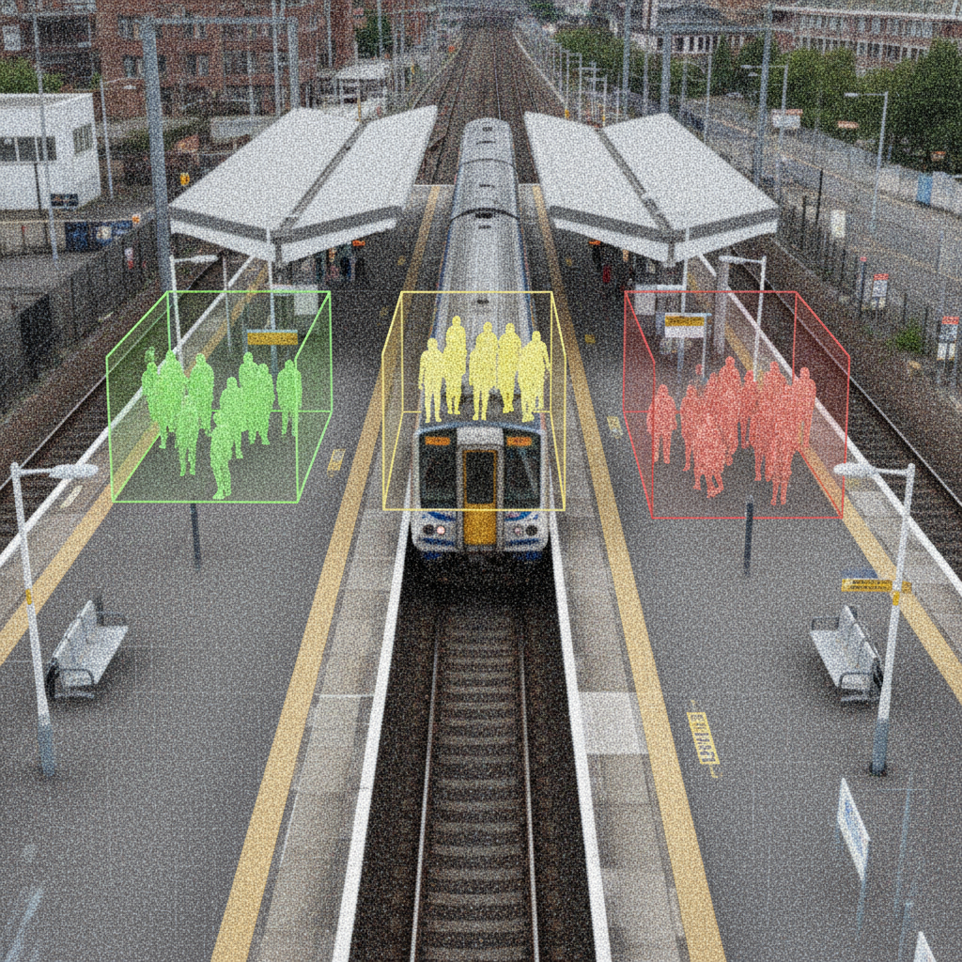
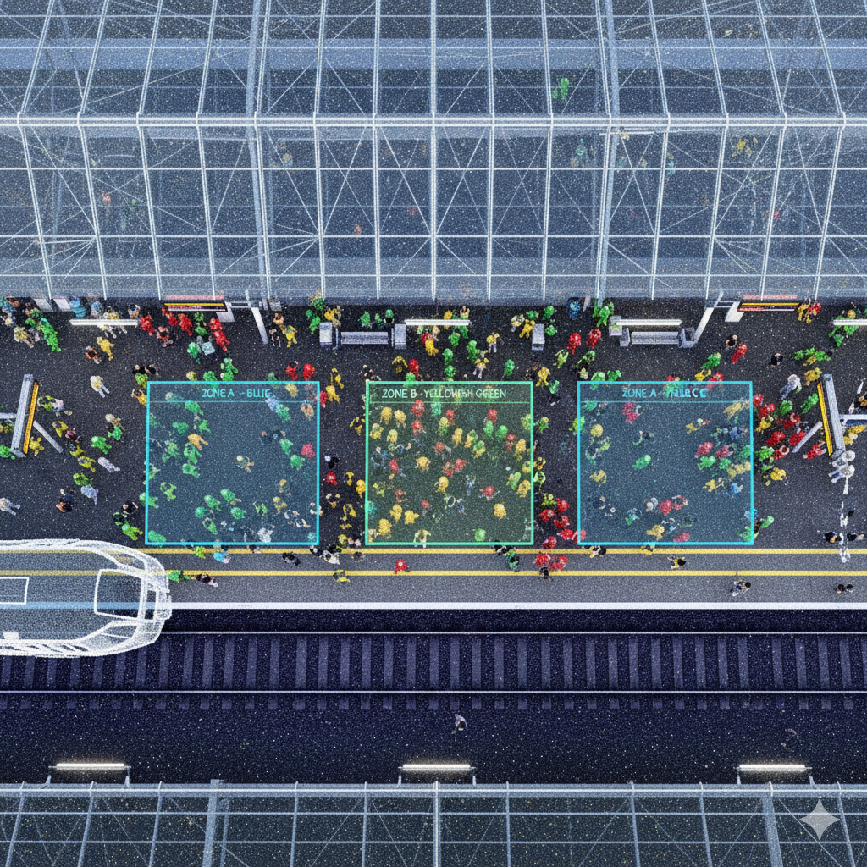
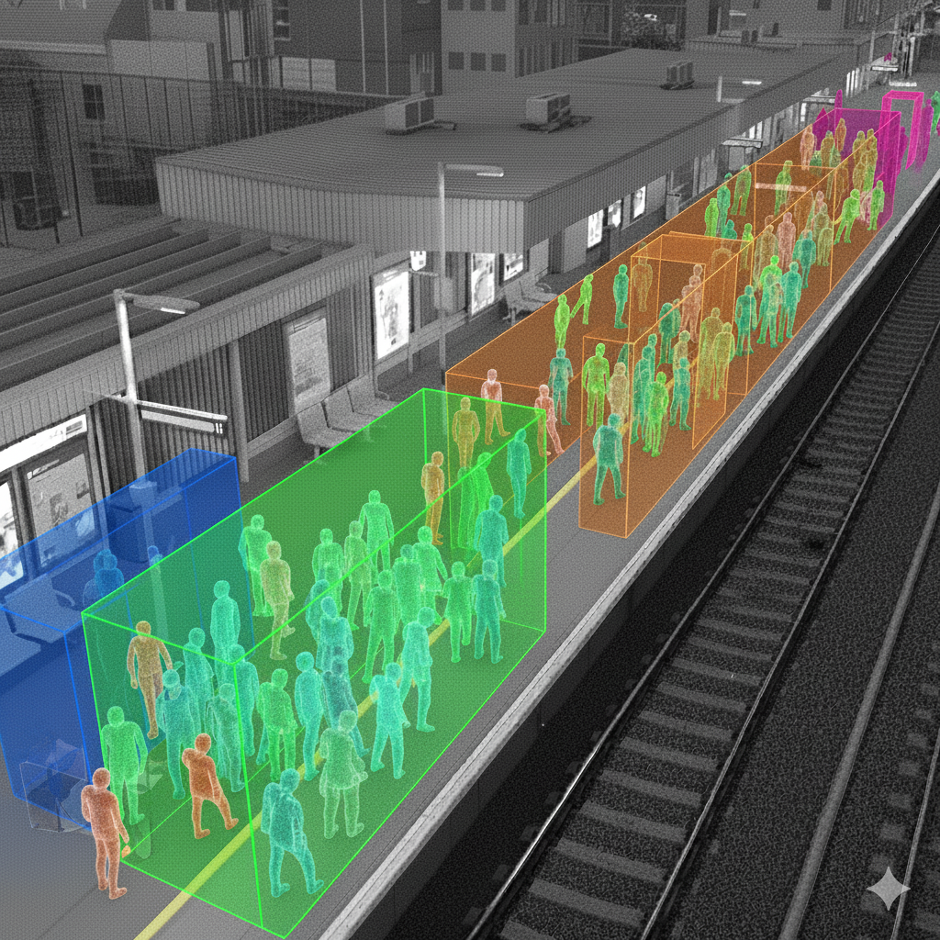

Slide 7
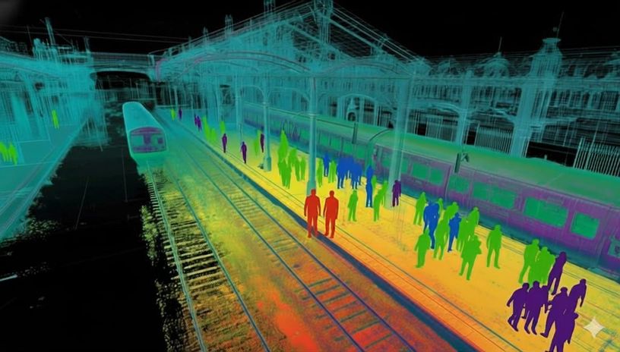
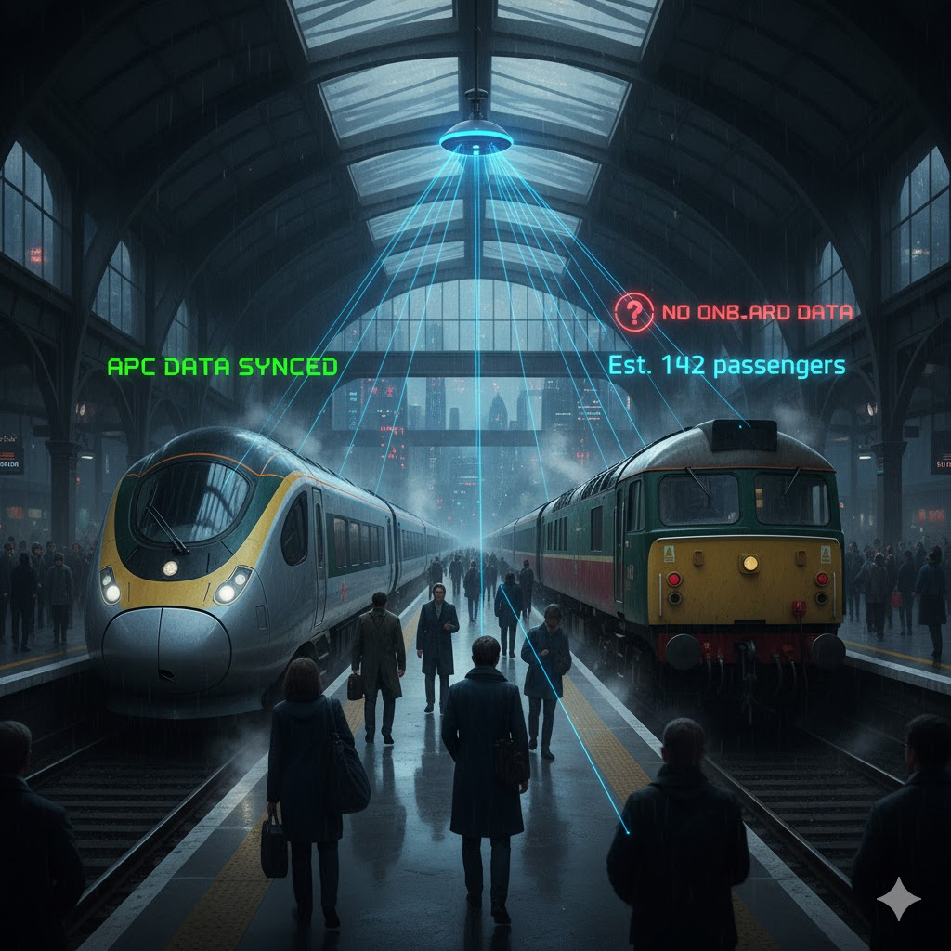
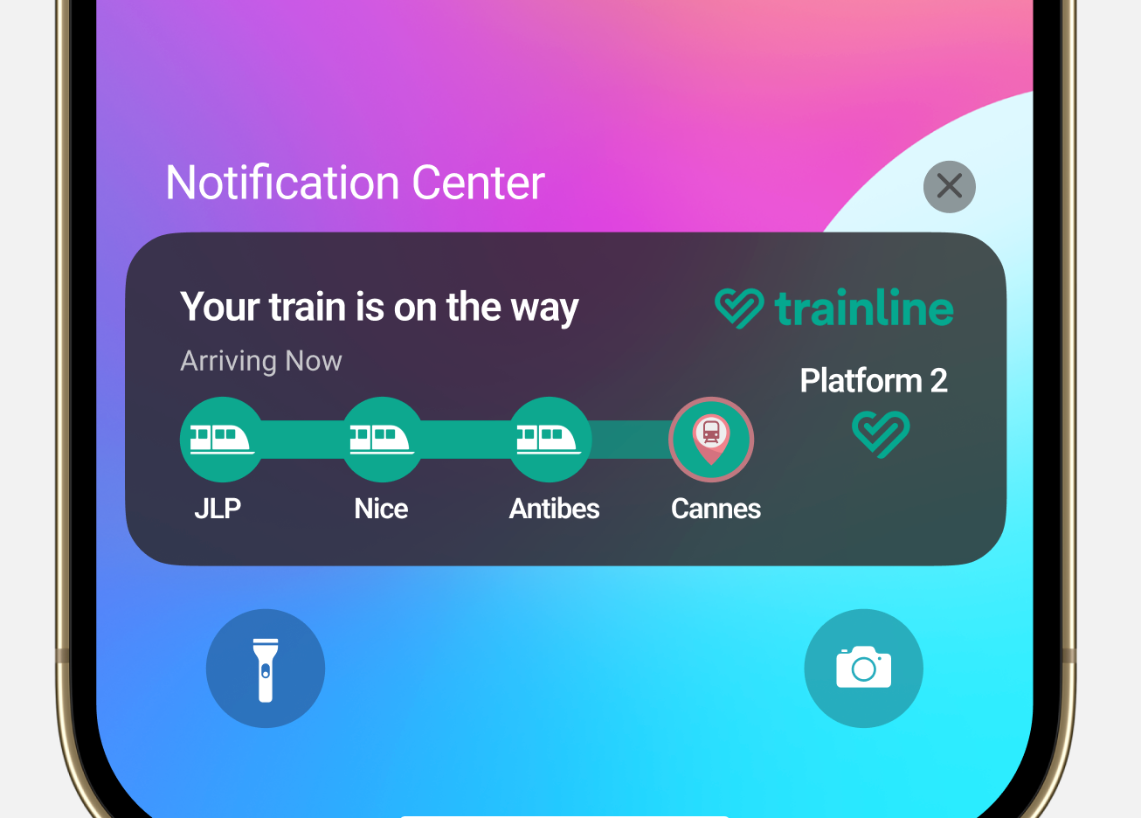
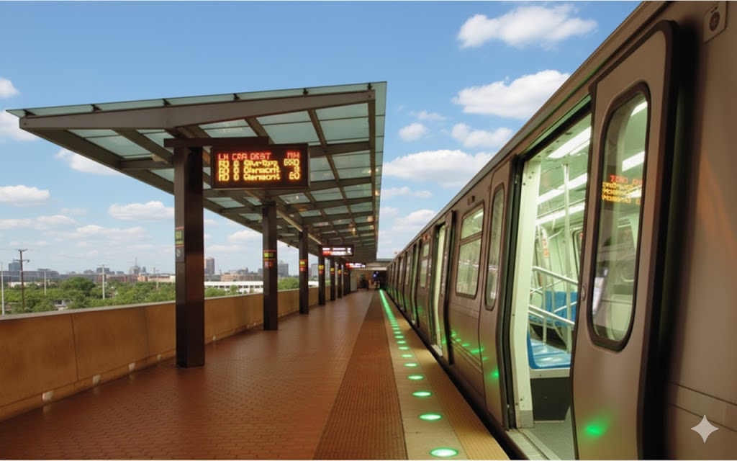
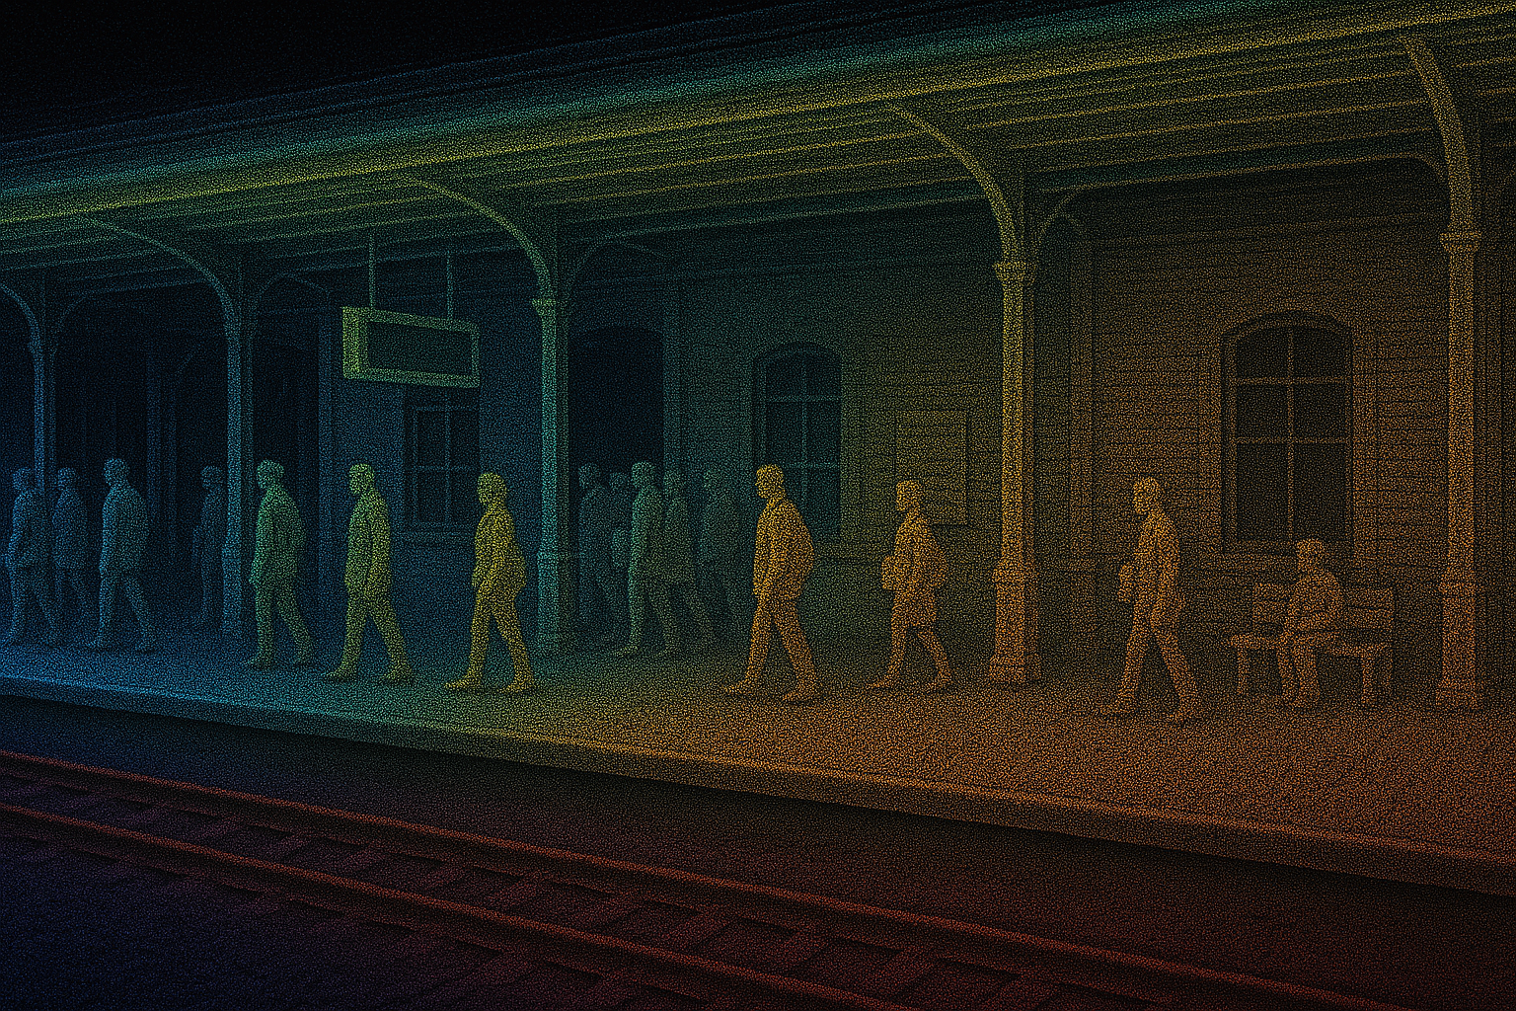
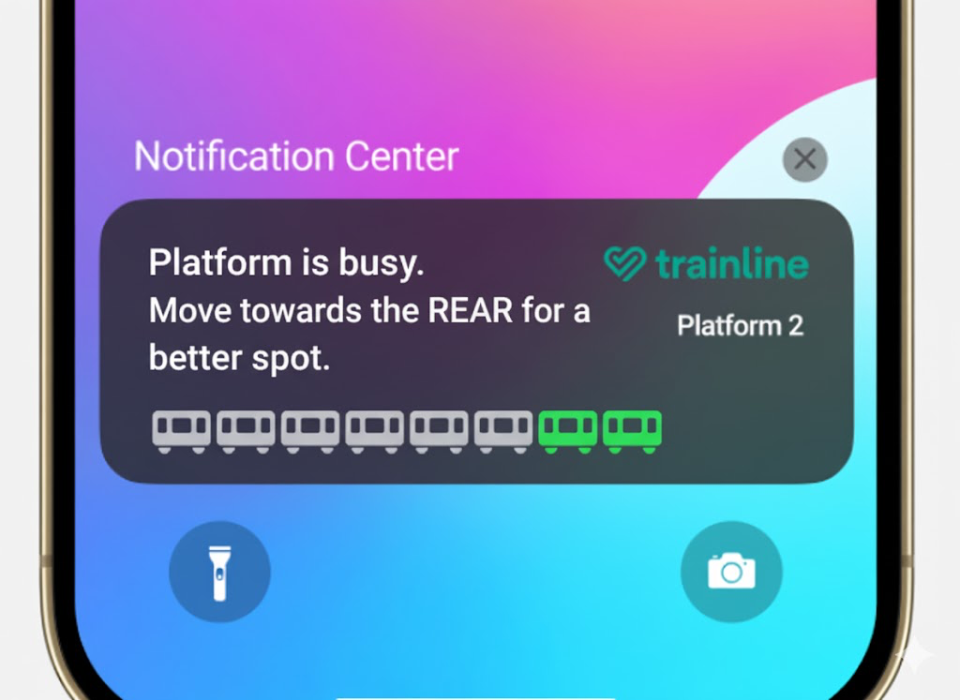
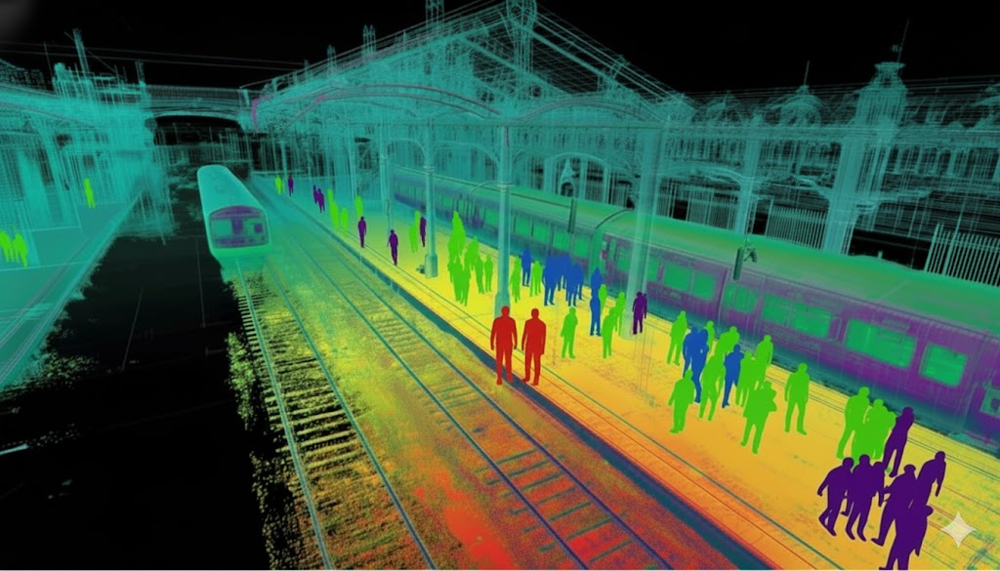
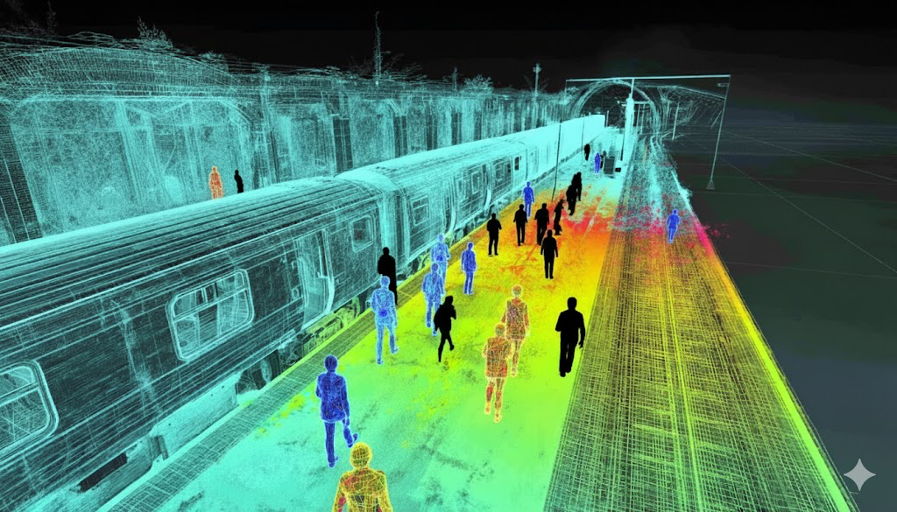
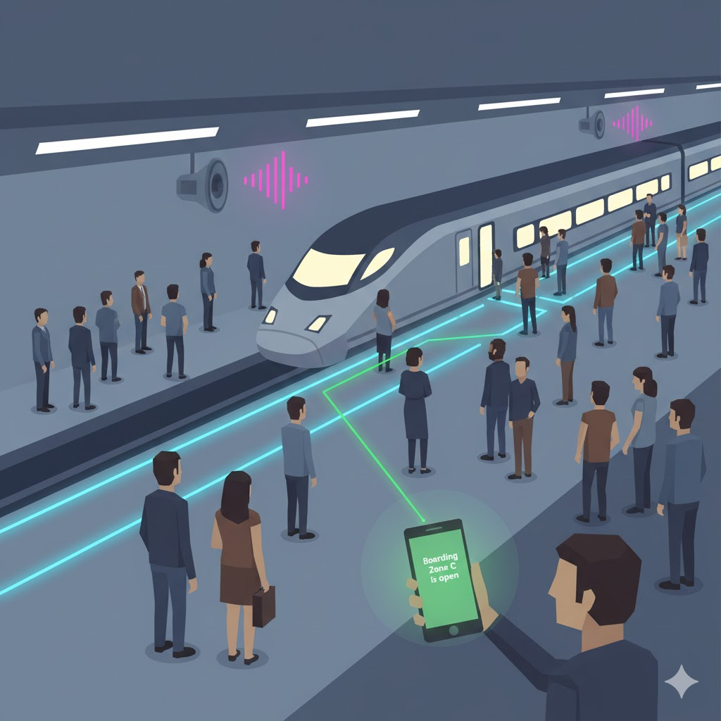
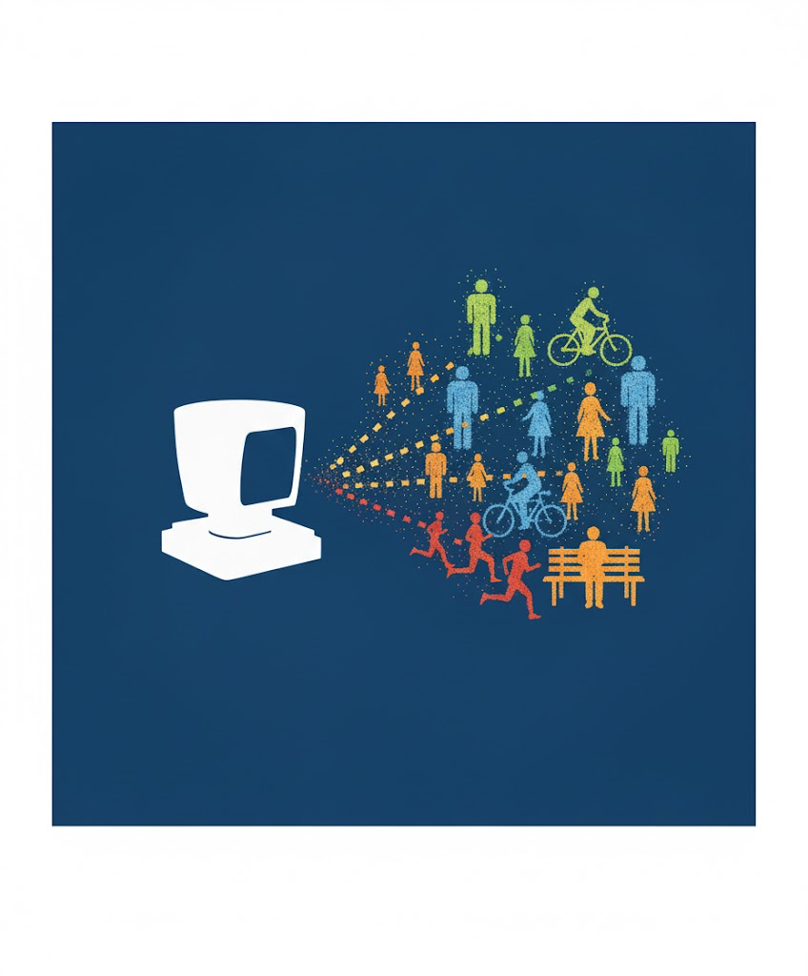
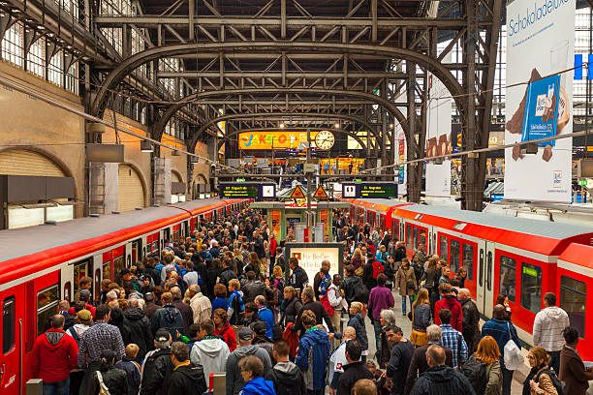
ToniDesign
Existing Passenger Counting & The LiDAR Advantage
Carousel Slide Text:
How It Works Now: Many modern trains use Automatic Passenger Counting (APC). Infrared sensors in the ceiling count people on and off. Advanced systems, like those on new Avanti West Coast Hitachi trains, fuse this with seat reservation data and seat load sensors for high accuracy.
The Challenge: This technology isn't universal. A significant portion of the UK's rolling stock lacks these systems, creating a "data black hole" for operators trying to manage load and distribution.
LiDAR's Solution: Platform-based LiDAR bridges this gap. By tracking historical boarding and alighting numbers at each station, the system can "talk" to other stations on the line. With enough data, a predictive model can accurately estimate the passenger load of anytrain, regardless of its onboard technology.
Existing Passenger Counting & The LiDAR Advantage
Carousel Slide Text:
How It Works Now: Many modern trains use Automatic Passenger Counting (APC). Infrared sensors in the ceiling count people on and off. Advanced systems, like those on new Avanti West Coast Hitachi trains, fuse this with seat reservation data and seat load sensors for high accuracy.
The Challenge: This technology isn't universal. A significant portion of the UK's rolling stock lacks these systems, creating a "data black hole" for operators trying to manage load and distribution.
LiDAR's Solution: Platform-based LiDAR bridges this gap. By tracking historical boarding and alighting numbers at each station, the system can "talk" to other stations on the line. With enough data, a predictive model can accurately estimate the passenger load of anytrain, regardless of its onboard technology.

Slide 8
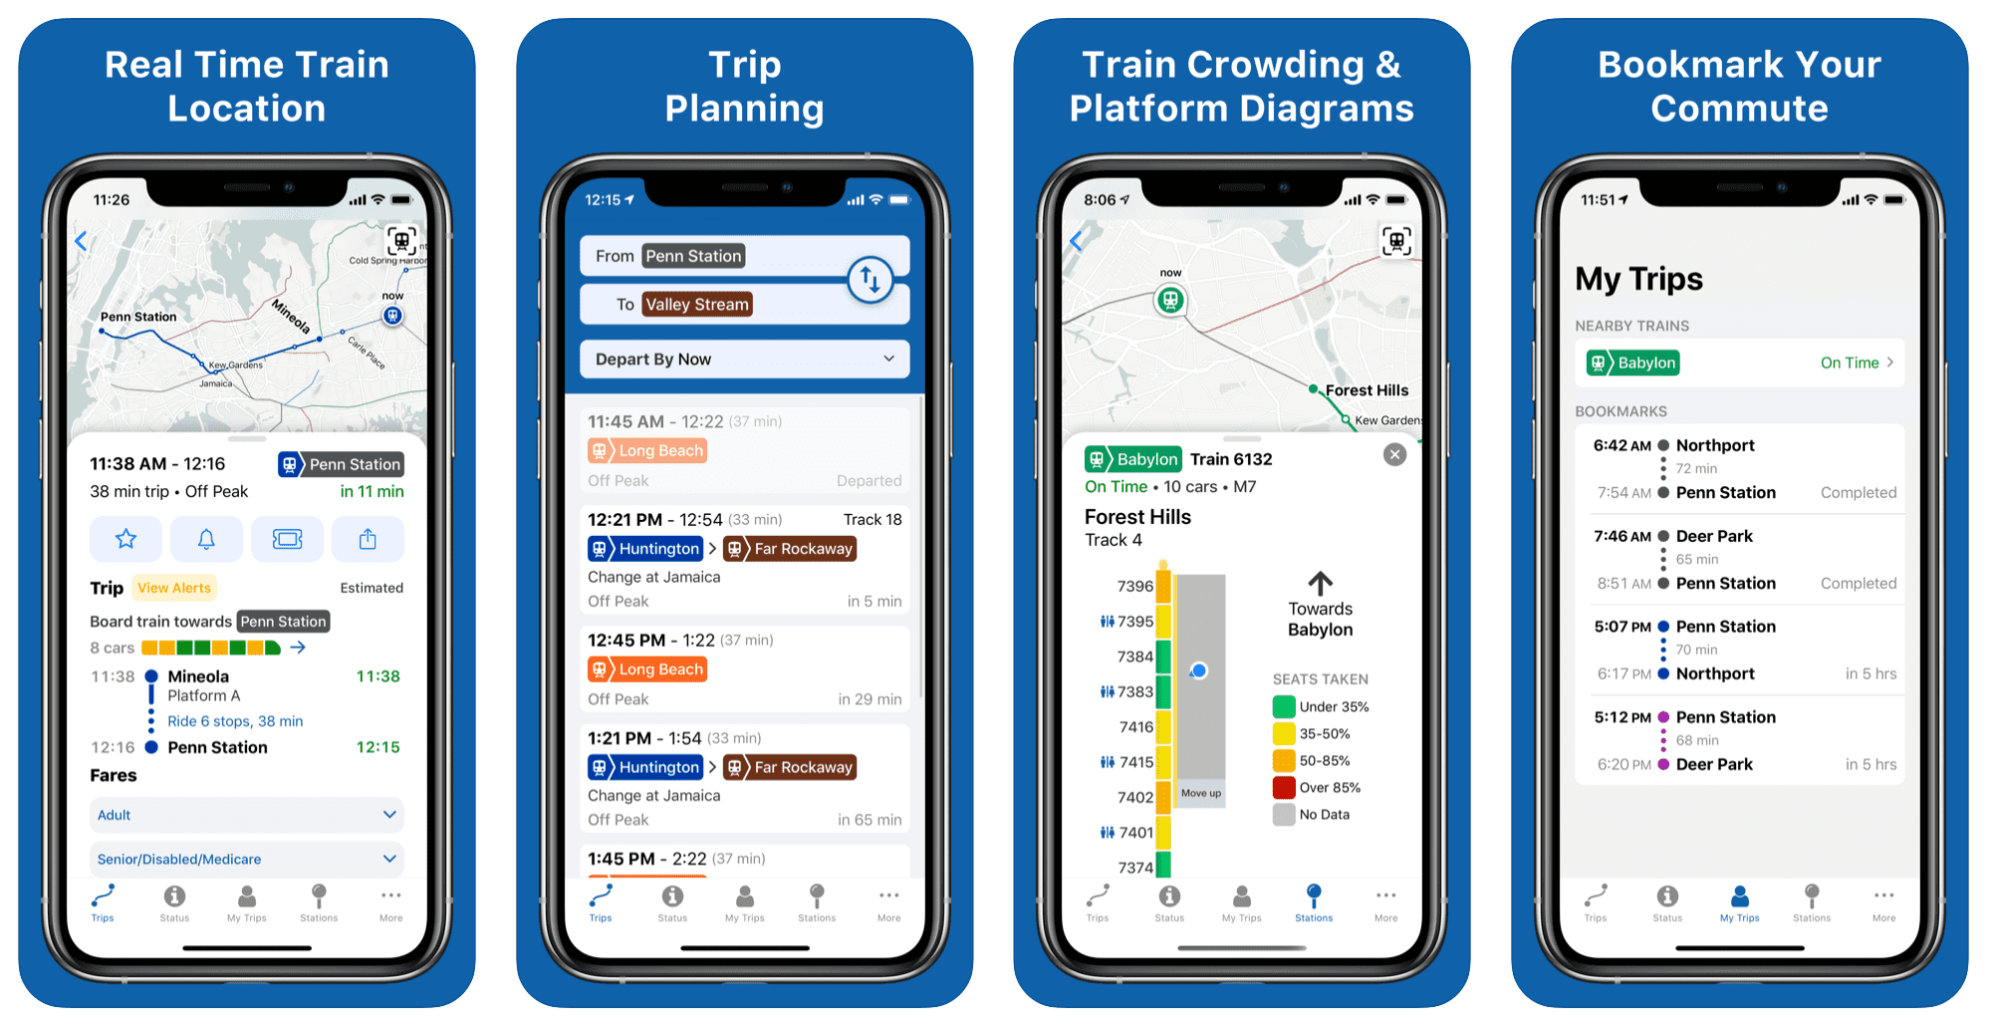
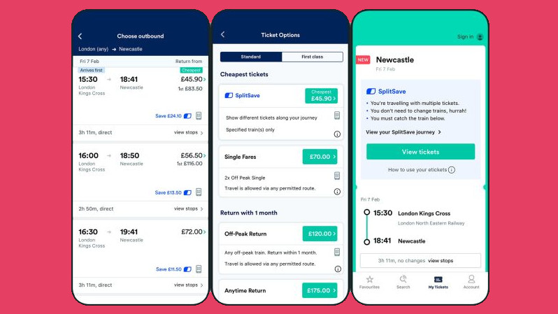
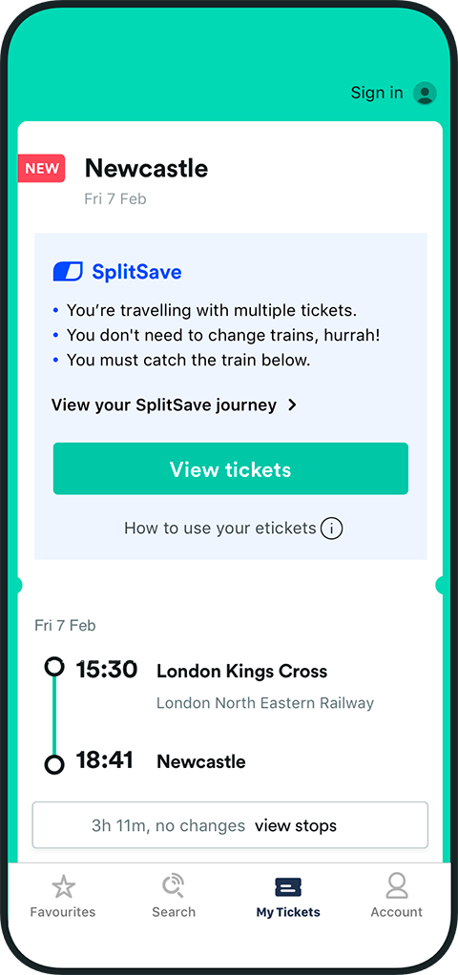
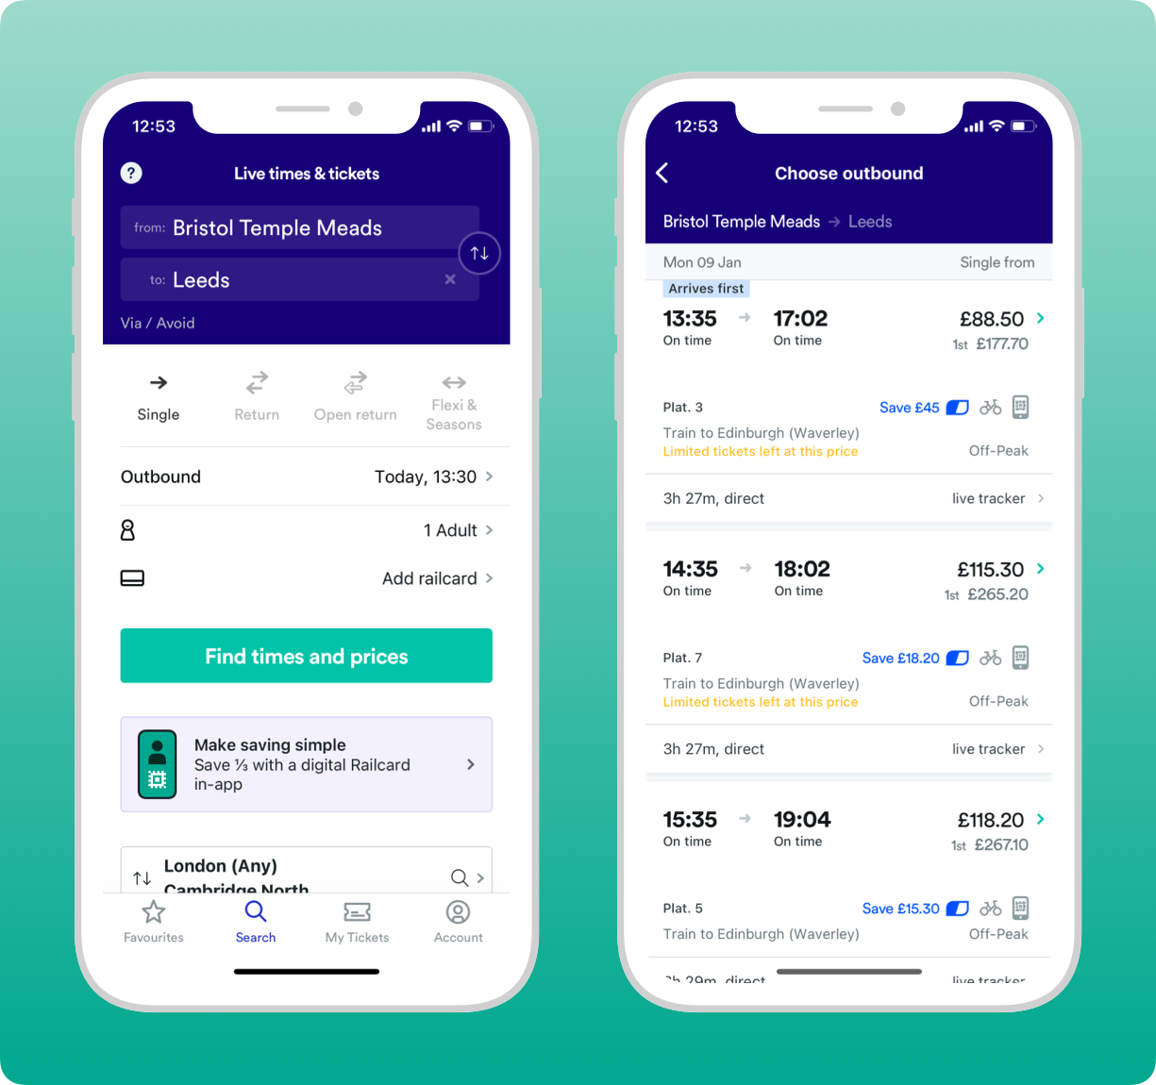
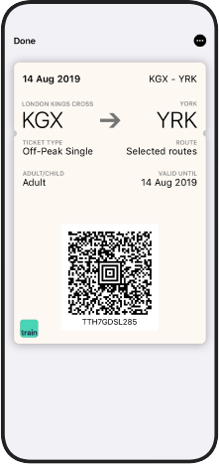
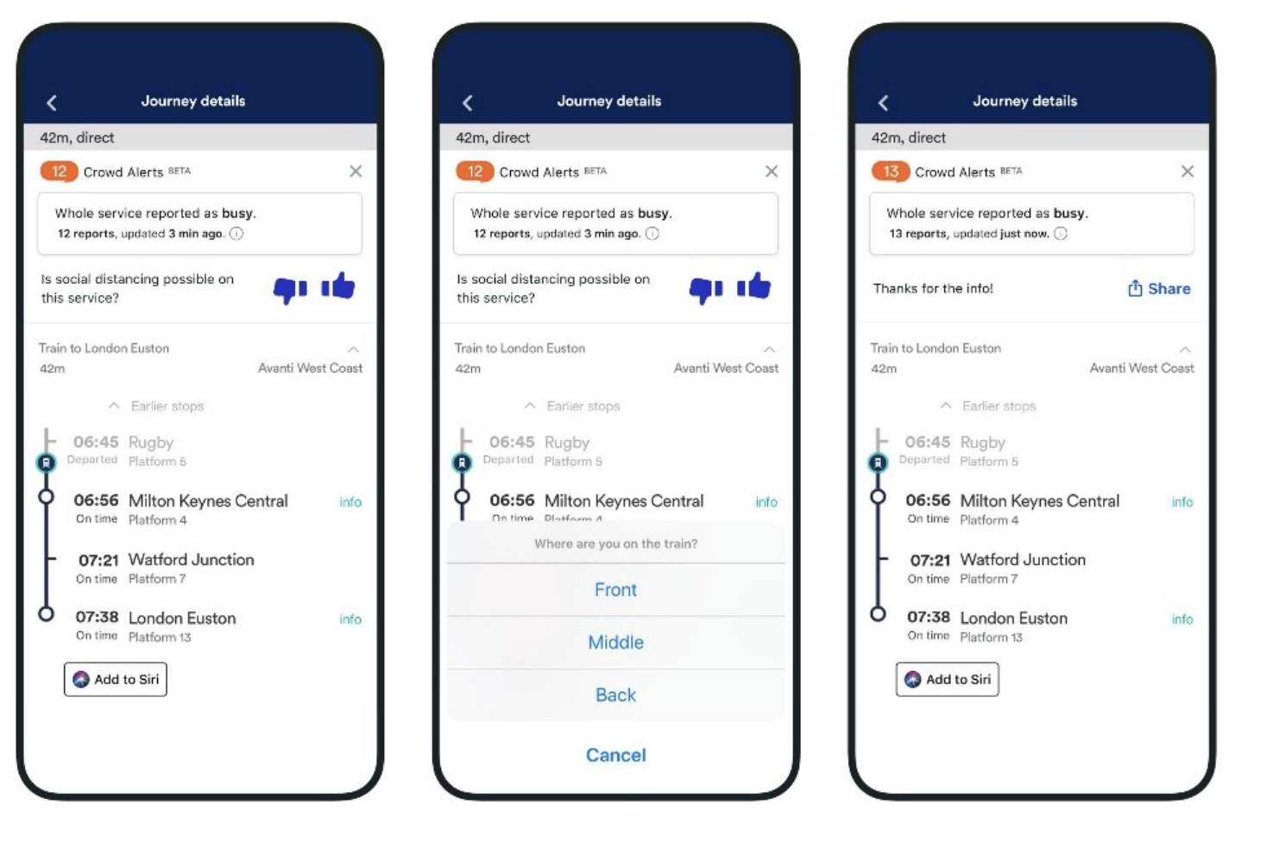

Slide 9
Info for header page
The Thameslink core is timetabled for a maximum of 24tph, a train every 2.5 minutes. Each train is expected to stand for 60 seconds, with 47 seconds of doors open and 13 total of opening and closing doors. That route runs on ATO (Automatic Train Operation) where the driver only closes the doors.
Intercity trains will usually be timetabled for a minimum of 2 minutes at each station, and usually 3+ at major stations.
Despite Thameslink trains taking more people, it’s a lot easier to get on/off Thameslink trains than, say, IETs or HSTs - due to the differences in standing capacity, door location and luggage storage.
0.90 passengers per second per door, with median values often around 0.82 passengers per second per door.
For example, if we look at the North West & Central region standard dwell times at stations:
Standard: 30 seconds
Class 170 & 185s: 45 seconds
Class 22x: 1 minute 30 seconds
Class 350: 45 seconds
Class 80x: 2 minutes (AWC) or 1 minute 30 seconds (TPE)
Loco Hauled: 1 minute
HST: 1 minute and 30 seconds
You also have standard information on platform reoccupation - 3 minutes same direction for example.
https://www.networkrail.co.uk/industry-and-commercial/information-for-operators/operational-rules/
Different nudge techniques ssuch as mobile phones or itneltigent lighting on platform
Or dynamic LED screesn
From history: 80% of passengers on at
This time are boarding train for this train etc
Lidar can idneify other passenger types such as wheelchair users or people with bicycles to adjust boarding rate: if there’s a big cyclying event boarding rate can be adjusted and dwell time updated on database for the context of the event that happened on that day.

Slide 10
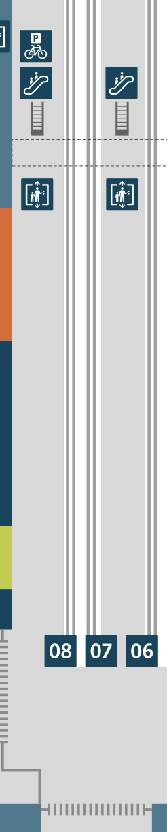


Slide 11
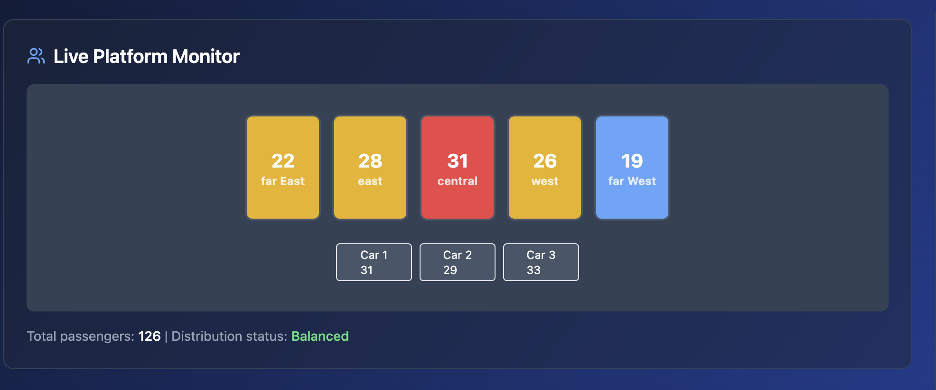
INSERT Pedstrian ICON HERE SO ITS CLEAR
A SMALL YELOW LINE ICON OR RAIL ICON

Slide 12
Need to add google maps app mockups and trainline/ greatwestertn etc
Need to add landing page with link to pdf of write up then link to dahsbord.
Need to make video of Lidar at BTM with midjoruney

Slide 13
Notes
On platfrom info screens it should say nothing opposed to “analyzing platform conditions,Please wait for boarding guidance”
Move the system acvitiy log up to below the current info scrren area
In the refrence/ ai context anlysis, it should show that its scraped the web for detail- ie for concerts ssay taylor swift concert on this day at nearby station etc. it can have some scenarios where things are combined ie football matches and a concert or events etc.
Need scenarios where there are more than 3 cars as well

Slide 14
